Slide 1
Capstone Project GLOBAL TERRORISM ANALYSIS By: Team Connecting Dots

Slide 2
INDEX
Introduction to team “Connecting Dots” ……………………………. Slide 3
What is Terrorism? …………………………………………………………….. Slide 4
How do countries define terrorism? ………………………………….. Slide 5 & 6
Brief about base data for the project …………………………………. Slide 7
Step by step approach to Data Analysis ……………………………… Slide 8
Resources used ………………………………………………………………….. Slide 9
Overview of dataset …………………………………………………………. Slide 10
Data Analysis ……………………………………………………………………… Slide 11 & 17
Challenges ………………………………………………………………………….. Slide 19
Conclusion ………………………………………………………………………….. Slide 20
Sources ……………………………………………………………………………….. Slide 21

Slide 3





TEAM CONNECTING DOTS
SAAQUIB MUSTAFA
SANDEEP
ARABINDA PATTNAIK
RAHUL MUKHERJEE
SAHIL KOLAMBKAR

Slide 4
WHAT IS TERRORISM?
The term “Terrorism” is derived from Latin word “Terror”, which refers to “great fear”. The word “Terrorism” was first used during French Revolution in the year 1795.
The term was used to refer to intentional or planned use of brutality and violence to create an environment of fright, panic, distress and fear in general public with the sole purpose of establishing a certain political or social native.
In todays world Terrorism is used by different parties in different perspective under different circumstances. Though UN Security Council recognises Terrorism as a threat to peace and security, but fails to define Terrorism in any of it resolutions and urges member countries to define Terrorism in their respective national law.
Accordingly different countries define Terrorism & Terrorist differently in their Laws.

Slide 5
HOW DO COUNTRIES DEFINE TERRORISM?
US Government / FBI defines and classifies terrorism as below:
International terrorism﻿: Violent, criminal acts committed by individuals and/or groups who are inspired by, or associated with, designated foreign terrorist organizations or nations (state-sponsored).
Domestic terrorism: Violent, criminal acts committed by individuals and/or groups to further ideological goals stemming from domestic influences, such as those of a political, religious, social, racial, or environmental nature.
(Source: https://www.fbi.gov/investigate/terrorism)

Slide 6
HOW DO COUNTRIES DEFINE TERRORISM? (cont.)
The Indian National Security Guard Act, 1986, defines a 'Terrorist' as: "Terrorist means any person who with intent to overawe the Government as by law established or to strike terror in the people or any section of the people, does any act or thing by using bomb, dynamite or other explosive substance or inflammable substances or firearms or other lethal weapons or poisons or noxious gases or other substances (whether biological or otherwise) of a hazardous nature, in such a manner as to cause or as is likely to cause, death or injuries to any person or persons or damage to or destruction of property, or disruption of any supplies or services essential to the life of community.“
(Who counts as a terrorist and what counts as terrorism is a debate that remains unresolved)
(Source: https://www.mea.gov.in/articles-in-indian-media.htm?dtl/15985/Terrorism+and+the+law++I)

Slide 7
BRIEF ABOUT BASE DATA FOR THE PROJECT.
We have use Global Terrorism Database (GTD) as base data for this project which is an open source online database and consists of detailed information regarding terrorists attacks that happened around the world since 1970 till 2017. The GTD is maintained by National Consortium for Study of Terrorism and Response to Terrorism (START), a Department of Homeland Security (DHS) Science and Technology (S&T) Center of Excellence. The data provides insights about date of event, number of casualties, target and location, type of attack, group claiming responsibilities and weapons used.
Users of this data include:
Department of Homeland Security
Department of Defence
Department of State
State Fusion Centres
Intelligence Community Agencies (federal, state and local)
Researchers and Students
Source: https://www.dhs.gov/sites/default/files/publications/start_global-terrorism-database_coe-factsheet_1611-508.pdf

Slide 8
STEP BY STEP APPROACH TO DATA ANALYZE.
Importing the necessary libraries in Python.
Mounting Google drive and creating the file path.
Importing Dataset from Drive.
Printing the information about a DataFrame including the index, dtype and columns, non-null values and memory usage.
Using Pandas library we did statistical analysis of the data whereas for visualization we used Matplotlib and Seaborn.

Slide 9




RESOURCES USED.
We used Python as programing language for analysing this data as it one of the most popular languages for machine learning and artificial intelligence. It’s well known for the great flexibility it offers.
We used Google Colaboratory, popularly known as Google Colab for writing and execution of Python codes because of its inherent benefits like Zero Configuration, free access to GPU and ease of sharing.
We used Pandas open source data manipulation and analysis tool for statistical analysis of the data. Pandas is well known for being fast, flexiable, powerful and ease of use
Matplotlib was used in the project for creating static interactive visualizations in Python.

Slide 10
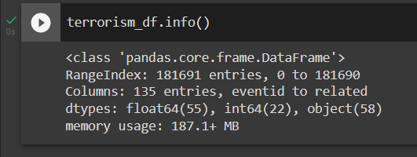
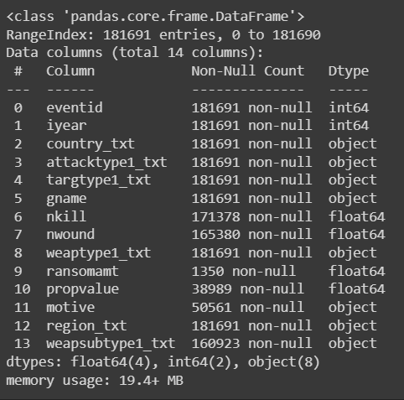
OVERVIEW OF THE DATASET.
Original Dataset
Filtered Dataset
Originally dataset had 181691 Rows and 135 Columns.
Post filtration of the data we have considered 181691 Rows and 14 Columns for the purpose of the analysis.

Slide 11
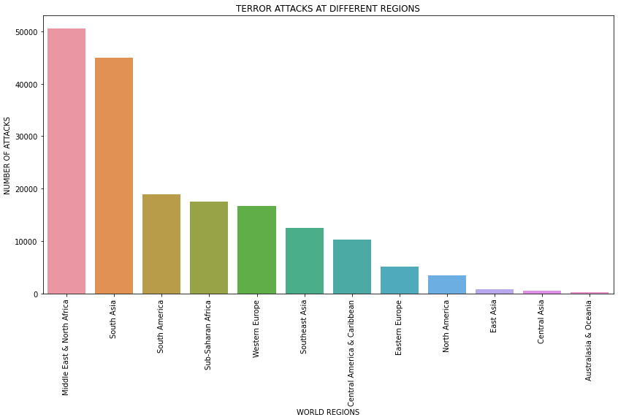
REGIONS SUFFERING MAXIMUM TERRORIST ATTACKS
Middle East and North Africa witnessed the highest number of terrorist attacks during the 1971 to 2017, followed by South Asia and South America.

Slide 12
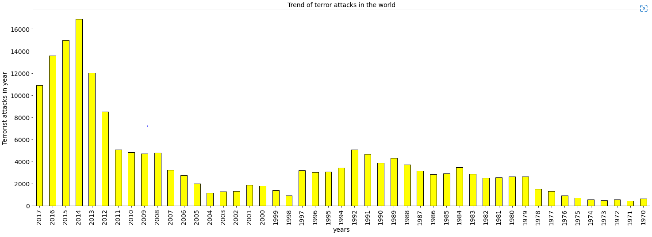
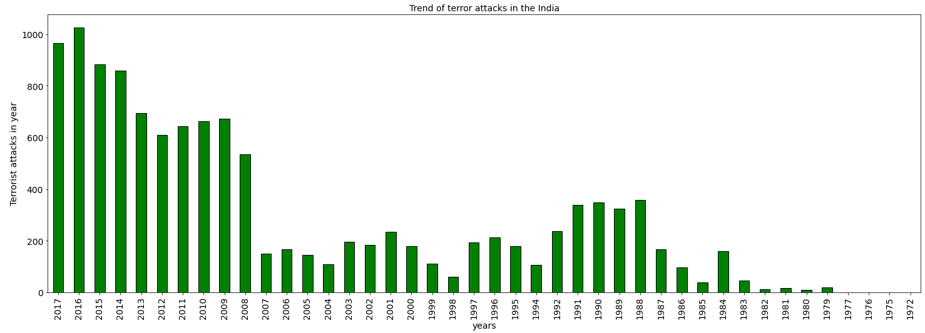
TREND OF TERROSIST ATTACKS
Though there has been fluctuations the trend however, it is evident that frequency of terrorist attacks has increased over the years.
Internationally highest number of terrorist attacks were observed in 2017 followed by 2015 & 2016. Whereas, in India the highest number of terrorist attacks were observed in 2016 followed by 2017 & 2015.

Slide 13
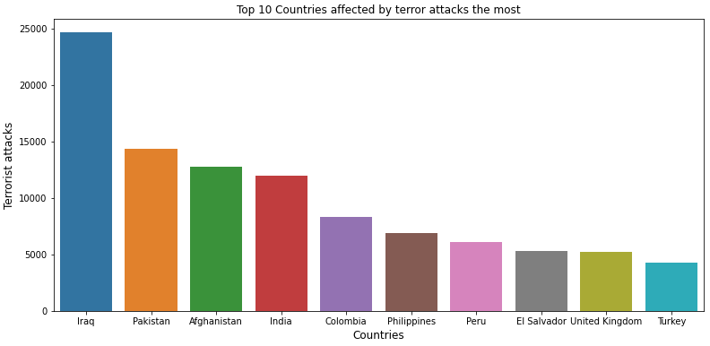
TOP 10 COUNTRIES IMPACTED BY TERROSISM
Iraq faced the highest number of terrorist attacks followed by Pakistan, Afghanistan and India.

Slide 14
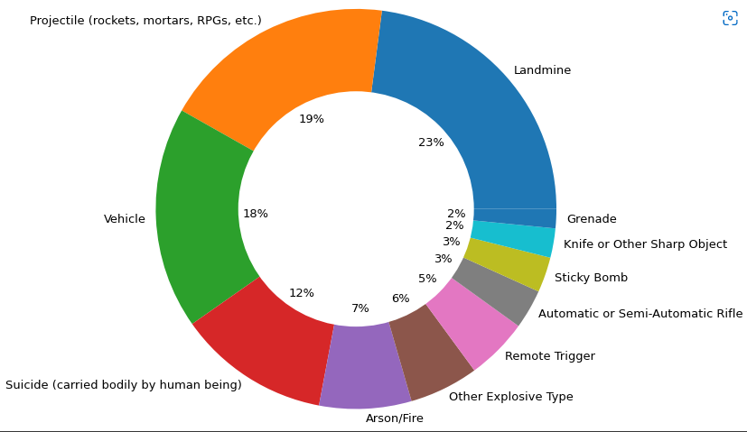
TERRORIST ORGANIZATION RESPONSIBLE FOR MOST ATTACKS
Per our analysis the highest number of attacks is done by Taliban and their most preferred weapon has been Landmine followed by usage of Projectiles like rockets, mortars, RPG, etc.

Slide 15
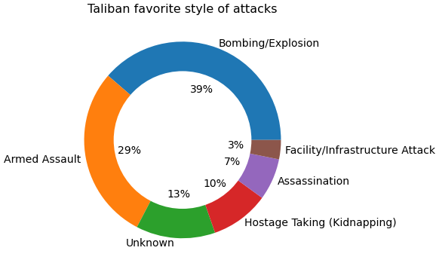
TALIBANS PREFERED STYLE OF ATTACK
The preferred style of Taliban is Bombing / Explosion followed by Armed Assault.

Slide 16
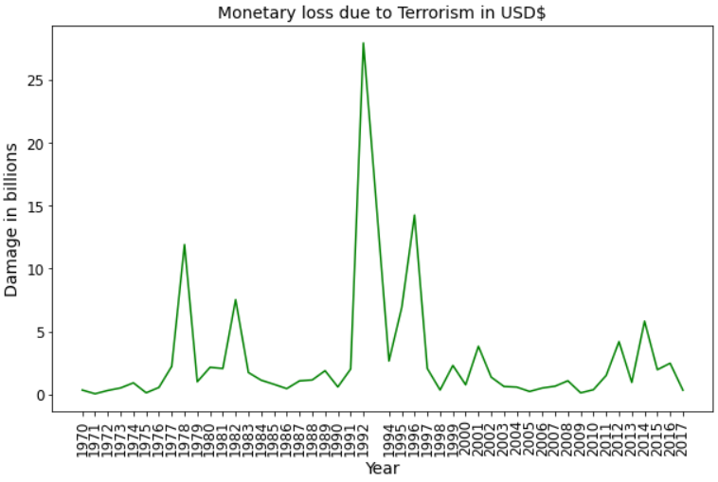
TREND OF ECONOMIC LOSSES FROM TERRORIST ATTACKS
The highest economic loss arising due to Terrorist attacks was in 1992, more than $25 Billion, followed by 1996 and 1978.

Slide 17
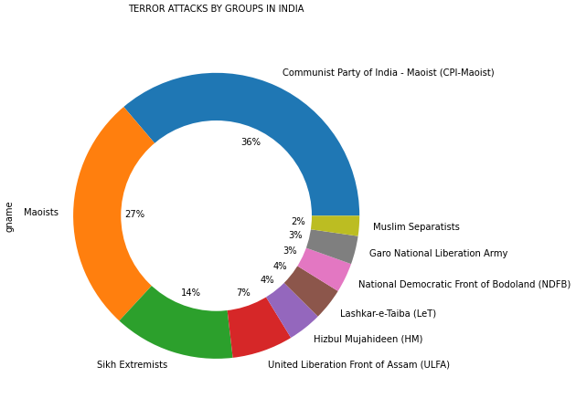
TERRORIST GROUPS RESPONSIBLE FOR ATTACKS IN INDIA
The highest number of terrorist attacks in India are carried out by CPI – Maoist followed by Maoist, Esikh Extremists and ULFA.
Moreover, 1877 attacks has been conducted by unidentified Terrorists.

Slide 18
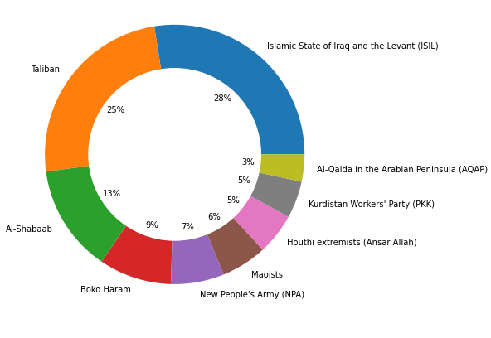
MOST ACTIVE TERRORIST ORGANIZATIONS IN LAST 5 YEARS IN THE WORLD
ISIL is the most active terror organization in the world followed by Taliban.
While the number of attacks by unidentified terrorists are 5613.

Slide 19
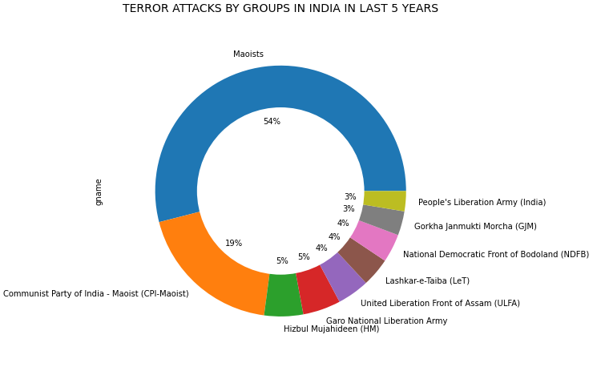
MOST ACTIVE TERRORIST ORGANIZATIONS FOR LAST 5 YEARS IN INDIA
MOIST Group is the most active terror organization in the India followed by CPI-Moist.
While the number of attacks by unidentified terrorists are 1163.

Slide 20
CHALLENGES
Initially we were not able to load data into Google Colab. We used encoding='latin1' to bypass the error.
While plotting the graphs they were getting Overwritten. We used Subplot function to solve the issue.
In Line Graph by default we get 5 values in x-axis. We used plt.Xticks([list of values for X-axis])to solve the issue.
By default values on X-axis are printed at 90° angle. We used plt.Xticks(rotation=0) to solve the same.
Creating donut pie chart was also a challenge as we had to overwrite a solid white circle on our existing pie chart and make sure our percentage values and pie chart labels don't get overwritten

Slide 21
CONCLUSION
It is evident form the trend analysis that since 1971 there has been significant increase in terror attacks globally. Terrorist Groups like ISIL, Taliban, Al-Shabaab, Boko Haram, NPA, Maoist are causing havoc throughout the world by bombing, armed assaults, assassination, etc. However, in recent times there has been slight decrease in terrorist attacks.
We need to understand that every human live is precious and we should take all efforts to curb terrorism and sponsors of terrorism. Development of both socio economic and educational are the only permanent solution to this problem.

